Slide 1
Web Application Framework

Slide 2
What is a WAF?
A software framework designed to simplify the development and maintenance of web applications, web services, web resources, and web APIs.
Provides a standardized structure and set of tools for building and deploying web applications.

Slide 3
Purpose of a WAF
Streamlines common tasks, such as handling user input, managing database connections, and implementing security features.
Encourages best practices and design patterns, leading to more maintainable and scalable applications.

Slide 4
Benefits of using a WAF
Faster development: Frameworks handle many repetitive tasks, allowing developers to focus on application-specific features.
Enhanced security: Built-in security features help protect against common web application vulnerabilities.
Improved maintainability: A standardized structure makes it easier for other developers to understand and maintain the code.
Scalability: Frameworks often include tools for building applications that can handle increasing loads and user demands.

Slide 5
What is a Web Service
A standardized way for applications to communicate with each other over the internet using HTTP.
Web services allow different applications, often built using different technologies and languages, to exchange data and functionality.

Slide 6
Benefits of using Web Services
Interoperability: Web services enable seamless communication between different applications and systems.
Reusability: They allow developers to reuse existing services and expose new services for others to consume.
Modularity: Web services promote the separation of concerns, making applications easier to maintain and scale.
Platform and language independence: Web services can be consumed by any application, regardless of the platform or programming language.

Slide 7
SOAP vs REST
SOAP (Simple Object Access Protocol): A protocol based on XML for exchanging structured information in the implementation of web services.
REST (Representational State Transfer): An architectural style for designing networked applications, often using HTTP and JSON for data exchange.

Slide 8
When to use SOAP?
When strict contracts and specifications are required
For applications that demand high levels of security and reliability
When dealing with legacy systems that already use SOAP
When working with applications that require stateful operations
Used in: Currency Conversion, FedEx/UPS Shipping and Tracking

Slide 9
When to use REST?
When simplicity and ease of implementation are important
For applications that need to scale easily
When working with web and mobile applications
When caching is necessary for improved performance
Used in: Twitter API, Google map API

Slide 10

Vaadin Web Application Framework
A Java web application framework that focuses on developer productivity and enjoyable user experience.
Allows for building modern, single-page web applications with a Java back-end and a Java or TypeScript front-end.

Slide 11

Vaadin and RESTful Web Services
Vaadin supports integration with RESTful web services, allowing developers to easily consume APIs and exchange data between the client-side and server-side.
Vaadin's built-in components, such as the Grid and ComboBox, can directly interact with RESTful web services to fetch and display data.
To implement RESTful web services in a Vaadin application, developers can use popular libraries like Spring Boot or Java EE

Slide 12
Using Vaadin in our project
Using Vaadin designer’s drag and drop interface, we can design and implement web pages easily, using layout templates, grid design and Vaadin's extensive library of pre-built components. These components can be connected directly to our service layer, or to web services.
Vaadin handles the communication between the server and the browser automatically. We don’t need to write any JavaScript to update content dynamically.
Implement real-time notifications and other interactive features using Vaadin's Push technology.

Slide 13

How to integrate Vaadin into our project
Add Vaadin dependencies to Maven
Install the Vaadin designer plugin for IntelliJ

Slide 14
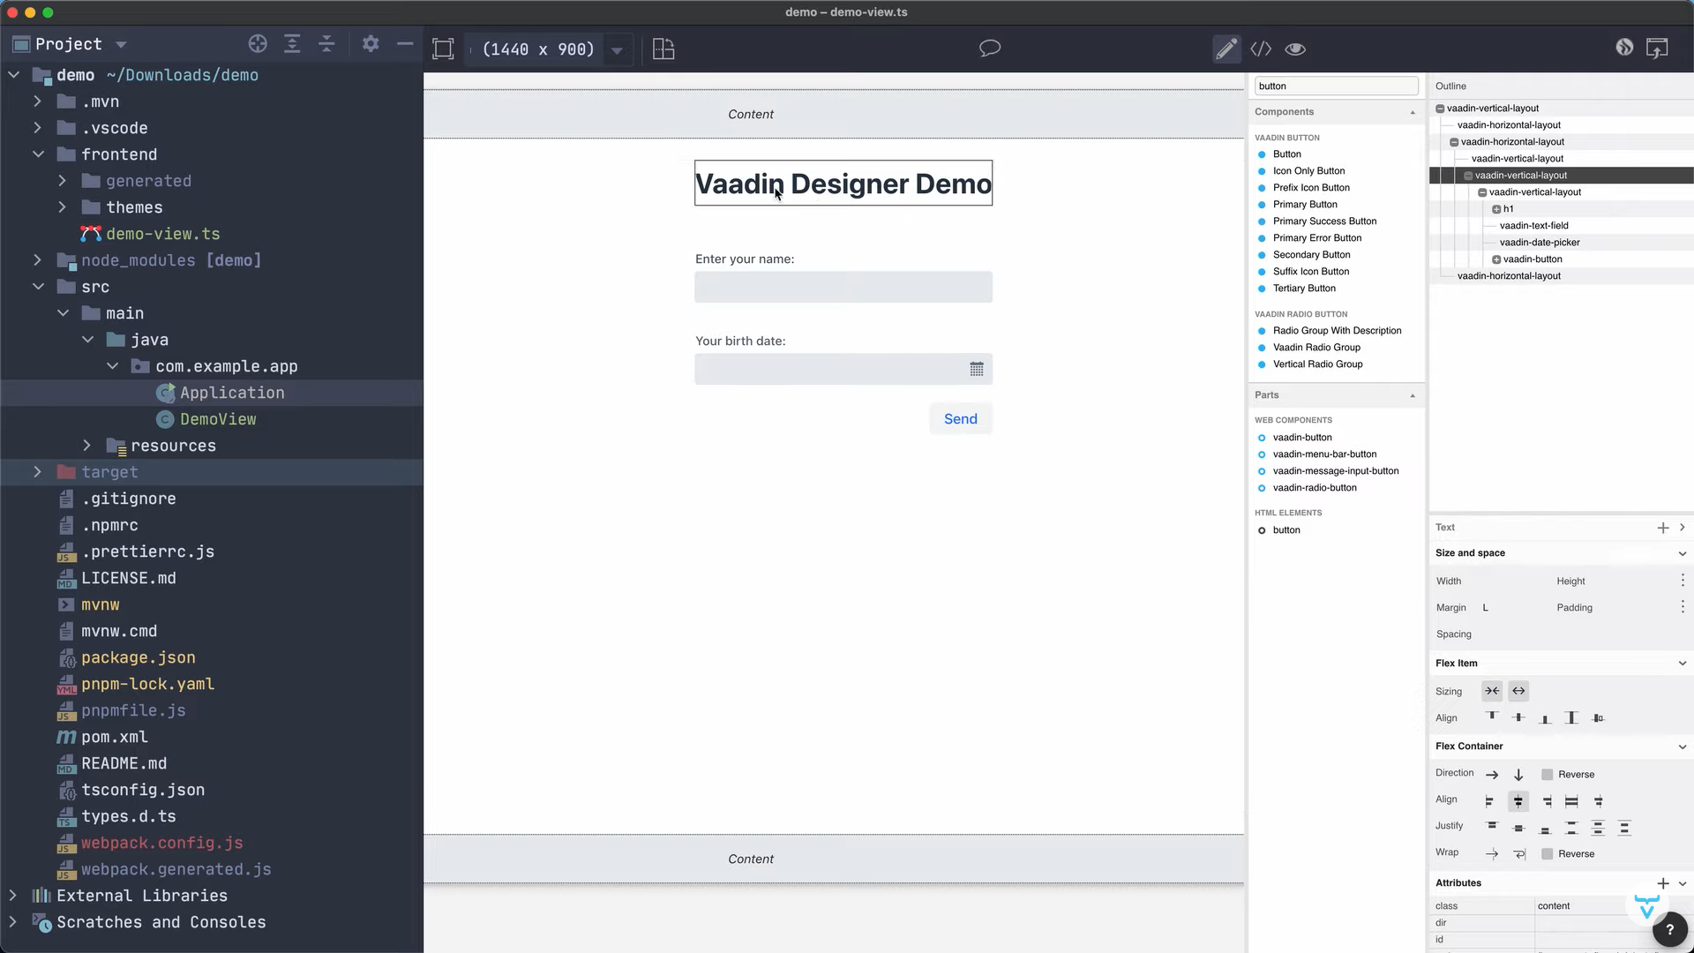

Slide 15
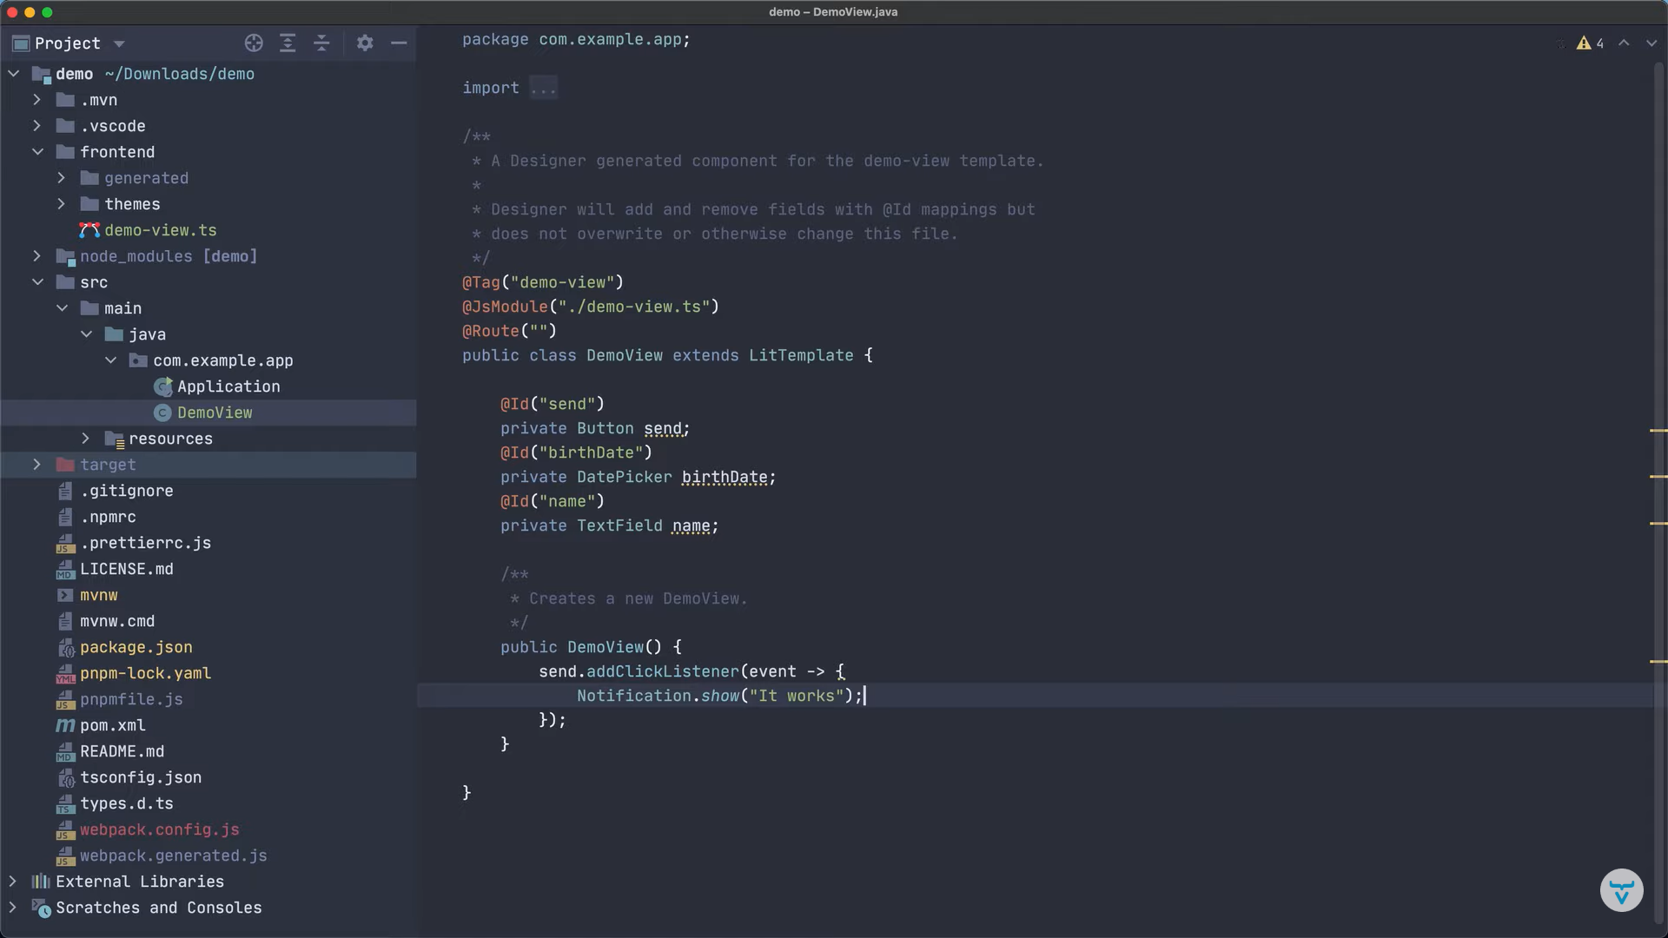

Slide 16
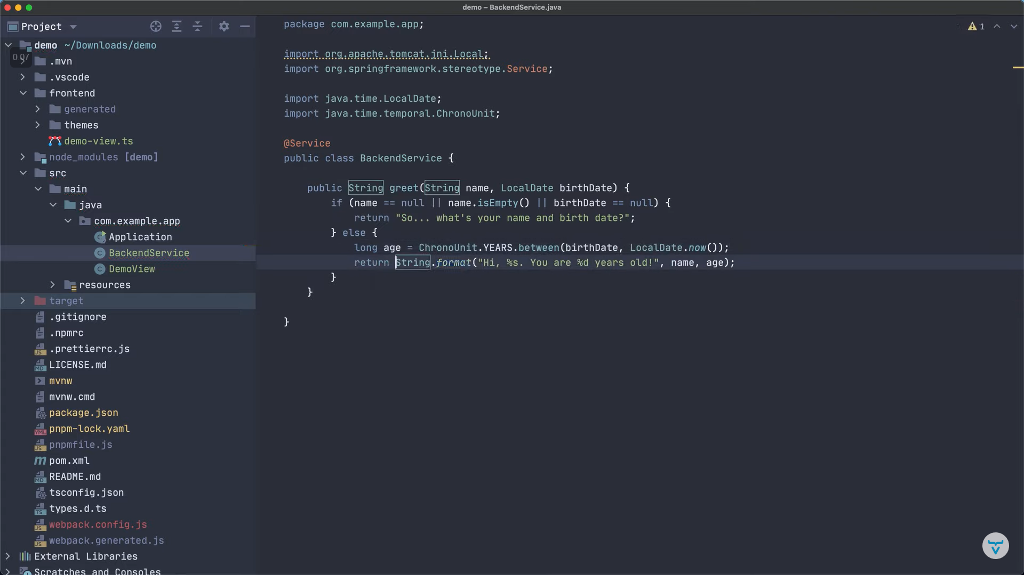

Slide 17
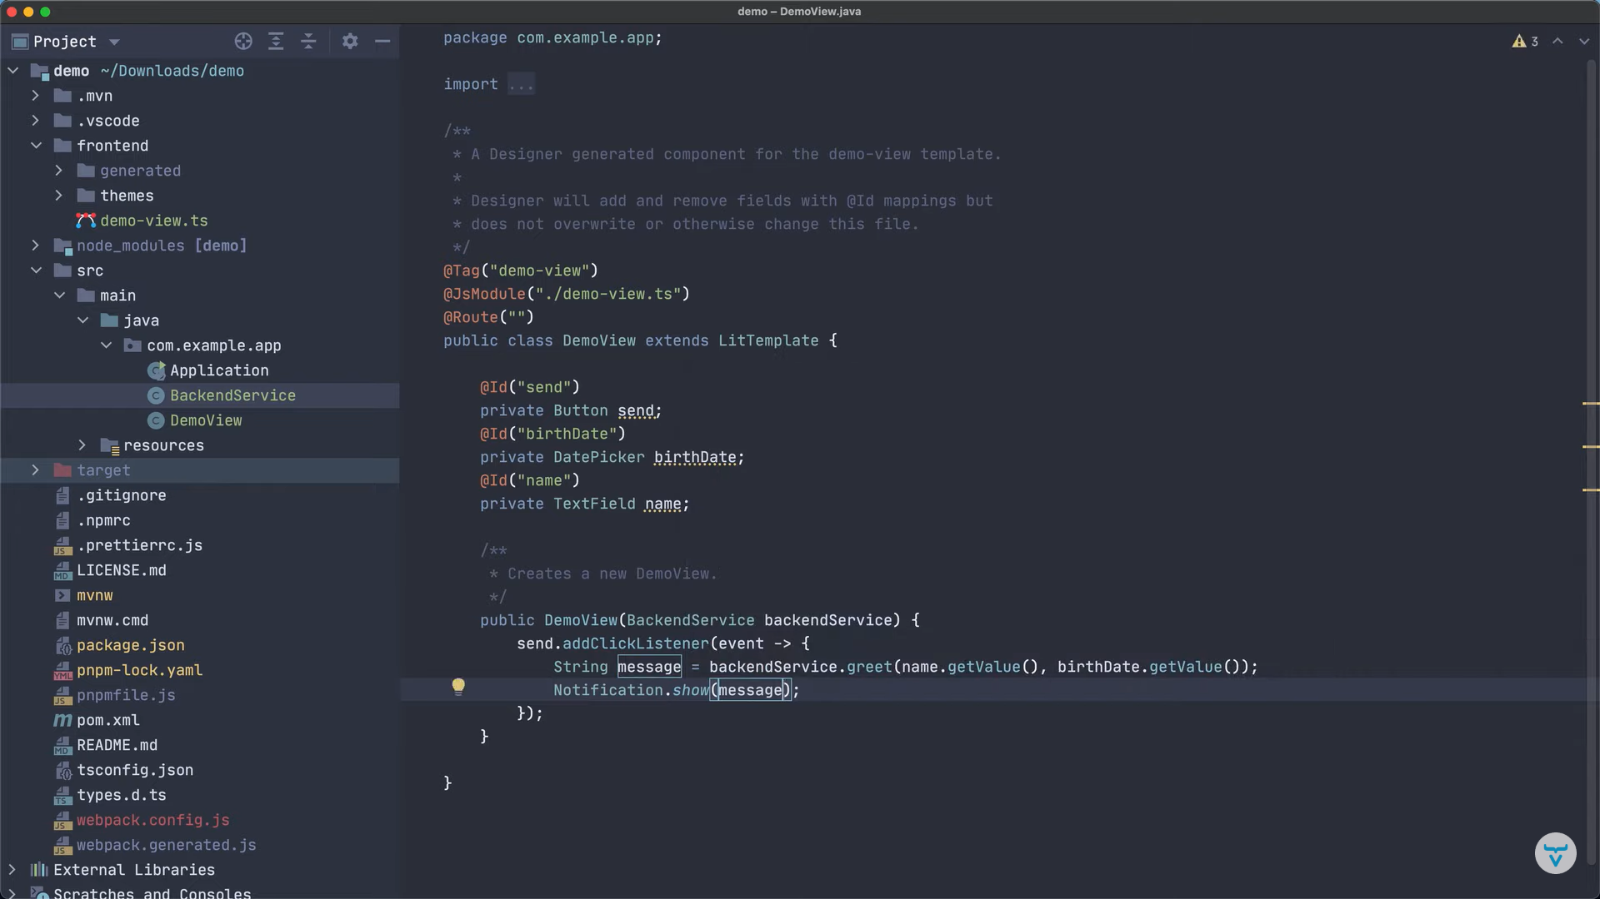

Slide 18
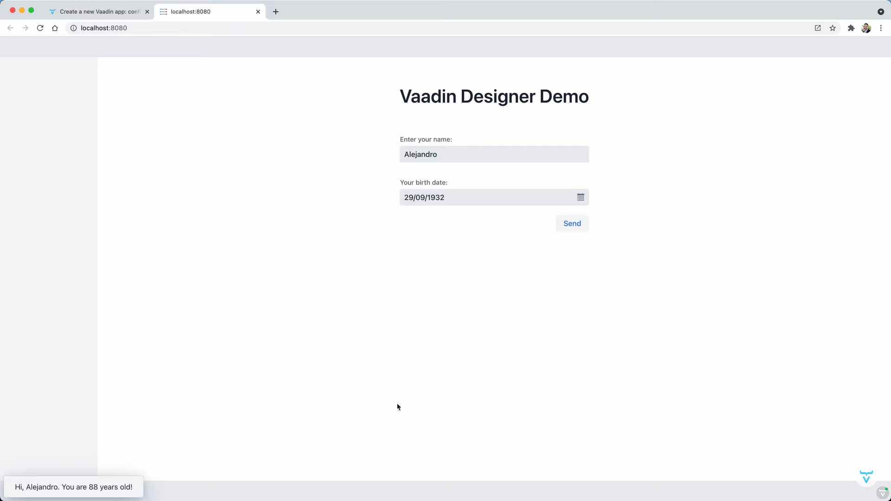

Slide 19

Real-Time Notifications with Vaadin
Vaadin supports real-time communication between the client and server, enabling the implementation of features like real-time updates, notifications, and interactive experiences.

Slide 20

Vaadin uses Push technology, which can be built upon WebSockets, long polling, or server-sent events, depending on the configuration and environment.
The @Push annotation can be used to enable Push in a Vaadin application, allowing the server to send updates to the client-side components.
The UI.push() method can be used to apply changes and push updates to the client.

